Slide 1
Student Database

Slide 2
STUDENT(snum: integer, sname: string, branch: string, levels: string, age: integer)
CLASS(cname: string, meetsat: string, room: string, fid: integer)
ENROLLED(snum: integer, cname: string)
FACULTY(fid: integer, fname: string, deptid: integer)

Slide 3
SCHEMA DIAGRAM
Student
SNUM
SNAME
BRANCH
LEVEL
AGE
Class
CNAME
MEETSAT
ROOM
FID
Enrolled
SNUM
CNAME
Faculty
FID
FNAME
DEPTID

Slide 4
SCHEMA DIAGRAM
Student
SNUM
SNAME
BRANCH
LEVEL
AGE
Class
CNAME
MEETSAT
ROOM
FID
Enrolled
SNUM
CNAME
Faculty
FID
FNAME
DEPTID

Slide 5
SCHEMA DIAGRAM
Student
SNUM
SNAME
BRANCH
LEVEL
AGE
Class
CNAME
MEETSAT
ROOM
FID
Enrolled
SNUM
CNAME
Faculty
FID
FNAME
DEPTID

Slide 6
SCHEMA DIAGRAM
1
Student
SNUM
SNAME
BRANCH
LEVEL
AGE
3
Class
CNAME
MEETSAT
ROOM
FID
Enrolled
SNUM
CNAME
4
Faculty
FID
FNAME
DEPTID
2

Slide 7
Create tables commands
CREATE TABLE STUDENT
(snum integer,
sname varchar(10),
major varchar(10),
levels varchar(2),
age integer,
PRIMARY KEY(snum));

Slide 8
CREATE TABLE FACULTY
(fid integer,
Fname varchar(10),
deptid integer,
PRIMARY KEY(fid));

Slide 9
CREATE TABLE CLASS
(cname varchar(10),
Meetsat varchar(10),
room varchar(5),
fid integer,
PRIMARY KEY(cname),
FOREIGN KEY(fid) references FACULTY(fid));

Slide 10
CREATE TABLE ENROLLED
(snum integer,
cname varchar(10),
PRIMARY KEY(snum, cname),
FOREIGN KEY(snum) references STUDENT(snum),
FOREIGN KEY(cname) references CLASS(cname));

Slide 11
SQL> SELECT * FROM STUDENT;
SNUM SNAME MAJOR LEVELS AGE
------ ---------- ---------- -- -------------------------------
101 Amit CS JR 21
102 Dilip CS SR 22
103 Samit CS SR 27
104 Ajay CS JR 20
105 Ramu CS SR 27

Slide 12
SQL> SELECT * FROM CLASS;
CNAME MEETSAT ROOM FID
---------- ---------- ----- -------------
DBMS 10 r04 501
WEB 10 r02 502
DAA 11 r03 503
MM 11 r128 502
DIPMAT 12 r04 504
OS 11 r128 501
CIP 10 r02 501
LAB 12 r03 501

Slide 13
SQL>SELECT * FROM ENROLLED;
SNUM CNAME
---------- --------------
101 DBMS
101 WEB
101 DAA
101 MM
101 DIPMAT
101 OS
101 CIP
101 LAB
102 DBMS
102 WEB
103 DBMS
104 DAA
105 DIPMAT
103 MM
105 DBMS
104 DBMS

Slide 14
SQL> SELECT * FROM FACULTY;
FID FNAME DEPTID
--------------- ---------- ------------------
501 Kuldeep 401
502 Akshata 402
503 Sanjeev 401
504 Math 405
505 Vidhya 403
506 Jog 404
507 Patil 402

Slide 15
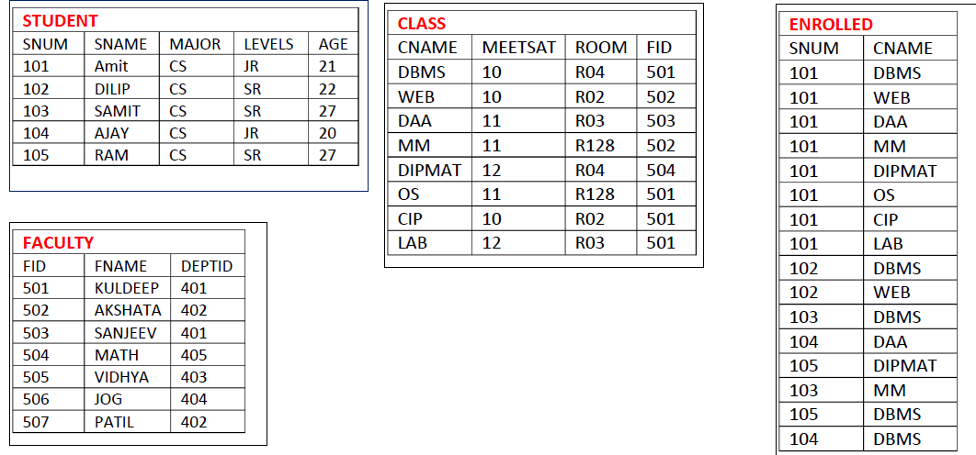


Slide 16
1)Find the names of all Juniors (level = JR) who
are enrolled in a class taught by Prof. kuldeep

Slide 17
1)Find the names of all Juniors (level = JR) who
are enrolled in a class taught by Prof. kuldeep
SELECT DISTINCT S.Sname
FROM STUDENT S, CLASS C, ENROLLED E, FACULTY F
WHERE S.snum = E.snum
AND E.cname = C.cname
AND C.fid = F.fid AND
F.fname = 'Kuldeep'
AND S.levels = 'JR';

Slide 18
2)Find the names of all classes that either meet in room R128 or have five or more Students enrolled

Slide 20
2)Find the names of all classes that either meet in room R128 or have five or more Students enrolled
SELECT DISTINCT C.cname
FROM CLASS C
WHERE C.room = 'r128'
OR C.cname IN (SELECT E.cname
FROM ENROLLED E
GROUP BY E.cname
HAVING COUNT(*) >= 5);

Slide 21
3)Find the names of faculty members who teach in every room in which some class is taught.

Slide 23
3)Find the names of faculty members who teach in every room in which some class is taught.
SELECT DISTINCT F.fname
FROM FACULTY F
WHERE NOT EXISTS(( SELECT room FROM CLASS)
Minus
(SELECT C1.room
FROM CLASS C1
WHERE C1.fid = F.fid ));

Slide 24
OR
3)Find the names of faculty members who teach in every room in which some class is taught.
SELECT fname
FROM faculty
WHERE fid in(
SELECT fid
FROM class
GROUP BY fid
HAVING count(distinct room) = (select count(distinct room) from class)
);

Slide 25
4) Write a SQL query to update the room number for DBMS course to S11.

Slide 27
4) Write a SQL query to update the room number for DBMS course to S11.
UPDATE CLASS
SET ROOM =‘S11’
Where cname=‘DBMS’;

Slide 28
Summary of SQL
SELECT (attribute and function)
FROM( TABLE LIST)
WHERE(CONDITION)
GROUP BY(Grouping attribute)
HAVING (group condition)
ORDER by (attribute list)

Slide 29
OVERVIEW
What is DDL and DML?
Various Types of DDL and DML?
Various constraints on SQL?
Schema change statements in SQL?
Basic query structure in SQL?
Various Aggregate functions in SQL?
Data types in SQL?
Group by, having clause and order by clause?

Slide 30
What is DDL and DML?
  The language which is used to alter table properties in called Data Definition language.
    Create - create table
    Alter - modify table values
    Delete - to delete attributes from tables
    Drop – to drop a table

Slide 31
DML
  The language that is used to modify table contents are called as Data Manipulation Language.
    Insert
    Update
    Delete

Slide 32
Various constraints in SQL?
  Not Null - Indicates that a column cannot store NULL value
  Unique - Ensures that each row for a column must have a unique value
  Primary key – combination of Not null and unique
  Foreign key -Ensure the referential integrity of the data in one table to match values in another table
  Check - Ensures that the value in a column meets a specific condition
  Default - Specifies a default value for a column

Slide 33
Schema change statements in SQL?
  Drop
  Alter
    Alter to add new column
    Alter to remove column
    Alter to set new datatype to column
    Alter to set default value to column

Slide 34
Basic query structure in SQL?
SELECT (attribute and function)
FROM( TABLE LIST)
WHERE(CONDITION)
GROUP BY(Grouping attribute)
HAVING (group condition)
ORDER by (attribute list)

Slide 35
Various Aggregate functions in SQL?
  Max
  Min
  Avg
  Count
  Sum

Slide 36
Data types in SQL?
  Integer
  Decimal
  Varchar(size)
  Char(size)
  Date
  Timestamp
  Number

Slide 37
Group by, having clause and order by clause?
  Group by – to group items by column value
  Having – to check condition meets
  Order by – to display in ascending or decending

